Slide 1
Introduction to Machine Learning

Slide 2
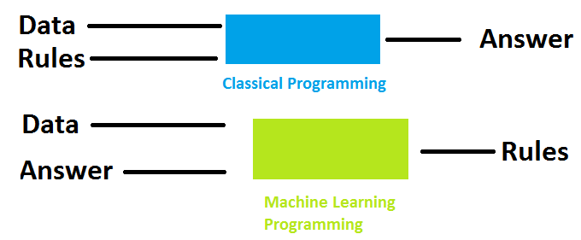
Goal For Machine Learning model:
Highest accuracy possible

Slide 3
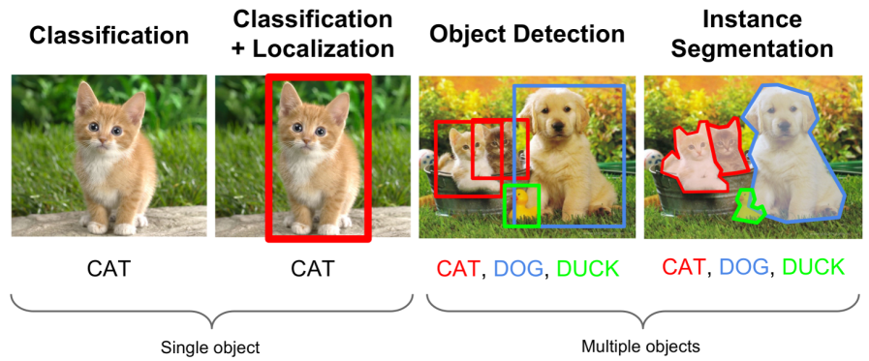
Machine Learning
-Machine learnning is the abiility to tech a computer without explicity programming it.
-Example are used to train computers to perform tasks that would be difficult to program.

Slide 4
Types of Machine Learning
Supervised Learning
Training data is lebeled
Goal is correctly lebel new data
Reinforcement Learning
Training data is unlebeled
System receives feedback for its action
Goal is to perform better action
Unsupervised Learning
Training data is unlebeled
Goal is to categorize the observations

Slide 5
Applications of Machine Learning
Handwriting recognition
Convert written letters into digital letters
Language translation
Translate spoken and or written languages (e.g. Google Translate)
Speech recognition
Convert voice snippets to text (e.g. Siri, Cortana, and Alexa)
Image Classification
label images with appropriate categories (e.g. Google Photos)
Autonomous Driving
enable cars to drive

Slide 6
Features in Machine Learning
– Features are the observations that are used to form predictions – For image classification, the pixels are the features – For voice recognition, the pitch and volume of the sound samples are the features – For autonomous cars, data from the cameras, range sensors, and GPS are features – Extracting relevant features is important for building a model – Time of day is an irrelevant feature when classifying images – Time of day is relevant when classifying emails because SPAM often occurs at night – Common Types of Features in Robotics – Pixels (RGB data) – Depth data (sonar, laser rangefinders) – Movement (encoder values) – Orientation or Acceleration (Gyroscope, Accelerometer, Compass)

Slide 7
Measuring Success for Classification
– True Positive: Correctly identified as relevant – True Negative: Correctly identified as not relevant – False Positive: Incorrectly labeled as relevant – False Negative: Incorrectly labeled as not relevant

Slide 8
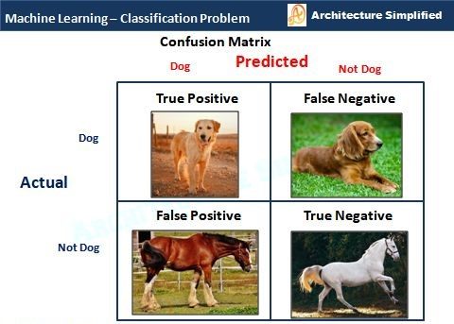

Slide 9
Precision, Recall, and Accuracy
– Precision – Percentage of positive labels that are correct – Precision = (# true positives) / (# true positives + # false positives) – Recall – Percentage of positive examples that are correctly labeled – Recall = (# true positives) / (# true positives + # false negatives) – Accuracy – Percentage of correct labels – Accuracy = (# true positives + # true negatives) / (# of samples)

Slide 10
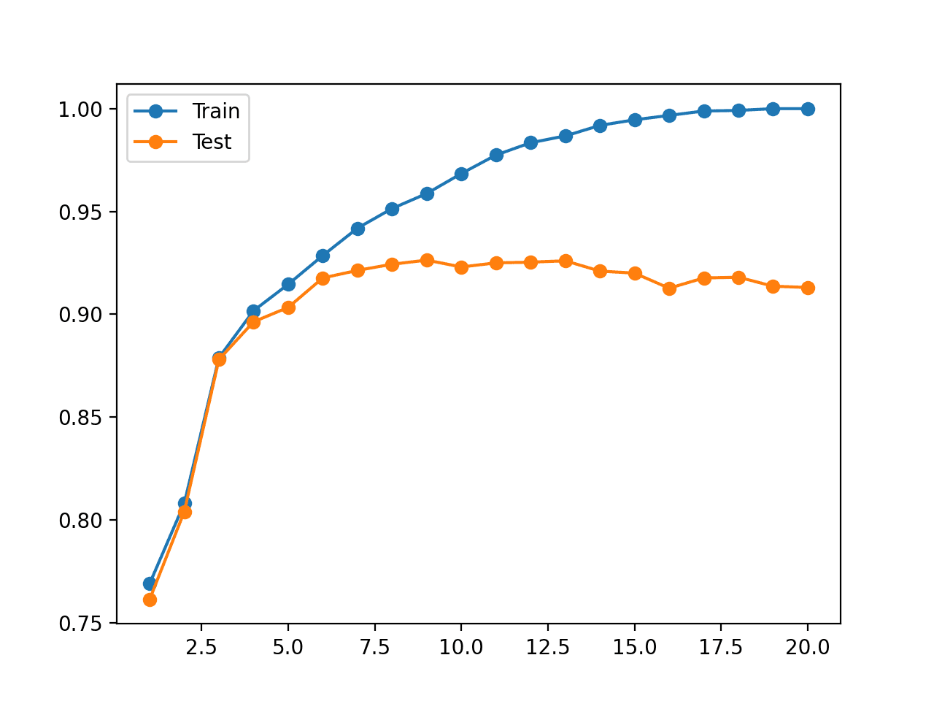
Training and Test Data
– Training Data – data used to learn a model – Test Data – data used to assess the accuracy of model – Overfitting – Model performs well on training data but poorly on test data

Slide 11
Bias and Variance
– Bias: expected difference between model’s prediction and truth – Variance: how much the model differs among training sets – Model Scenarios – High Bias: Model makes inaccurate predictions on training data – High Variance: Model does not generalize to new datasets – Low Bias: Model makes accurate predictions on training data – Low Variance: Model generalizes to new datasets

Slide 12
Supervised Learning Algorithms
– Linear Regression – Decision Trees – Support Vector Machines – K-Nearest Neighbor – Neural Networks

Slide 13
Supervised Learning Frameworks
Tool | Uses | Language
Scikit-Learn | Classification, Regression, Clustering | Python
Spark MLlib | Classification, Regression, Clustering | Scala, R, Java
Weka | Classification, Regression, Clustering | Java
Caffe | Neural Networks | C++, Python
TensorFlow | Neural Networks | Python

Slide 14
Machine Learning summary
Rather than giving the program the rules,an algorithm finds the rules for us.

Slide 15

Thank you

